Slide 1
Clustering of stocks with multispatial CCM
Multispatial CCM assumes that all replicates are truly from the same system. However, for many of our putative causal variables, we see significant causality at the MPG levels but not at the ESU level. I suspect that this is because the different stocks are not true replicates of the same system or they are part of the same system but at different parts of the attractor for that system.
In ‘2_Clustering_Chinook_stocks.Rmd’ I evaluate how similar each stock is to every other stock, I forecast each stock using a simplex EDM embedding of every other stock to create a matrix of pairwise similarity between stocks using the average forecast rho. To illustrate the results I used hierarchical cluster analysis to produce dendrograms at the ESU level and within each MPG (full disclosure: I don’t have much experience with dendrograms!). The hierarchical analysis uses a dissimilarity metric, so I used 1-rho as the measure.
I’m not sure if this is a logical way to think about the data. On the one hand: if you can easily forecast a stock based on an embedding of another stock, the assumption is that the factors driving their dynamics are mutual. On the other hand if you CAN’t easily forecast a stock based on an embedding of another stock, either there are different driving forces between the stocks (and they are actually different systems) or the sampling is insufficient and each stock is on a different part of the same attractor, or there is a ton of stochasticity and the sample size is insufficient.
If all the stocks are true replicates of the ESU, we would see all the stocks similar to each other and connected low on the y-axis - we don’t see this as the finally connections between groups occurs at 1 on the y-axis (rho~=0). If the stocks are not replicates, this would explain why we are getting so few significant causal effects at the ESU level.
If the MPGs were distinct from each other, we would see them group up by MPG. There is a little of that happening (e.g. IMN for the 5-year old recruit data), but for the most part they are mixed up.
That got me wondering if the same thing was happening at the MPG level, that is if the stocks within each MPG could reasonably be assumed to be replicates of the same system. It may be that if there is a stock that is very different from the rest in the MPG, leaving it out would lead to cleaner results. So, I ran the same hierarchical analysis within each MPG. I then chose a dissimilarity of 0.7 (rho of 0.3) to cut the dendrogram into clusters of stocks that are more similar to each other than the whole MPG. (Each cluster needed at least 2 stocks for sample size limitations).
I then ran the CCM analysis at the ESU, MPG levels and at the level of these hierarchical clusters to see if the CCM results improved at all. I’ve only pasted in the results for the Hatchery data, see the drive for the rest of the plots under Output > Figures > 3_CCM > multispatial. In many cases the smaller clusters produce slightly better results (lower p-value and higher rho). This is despite the fact that the sample size is smaller. In some cases it flags different causal variables.

Slide 2
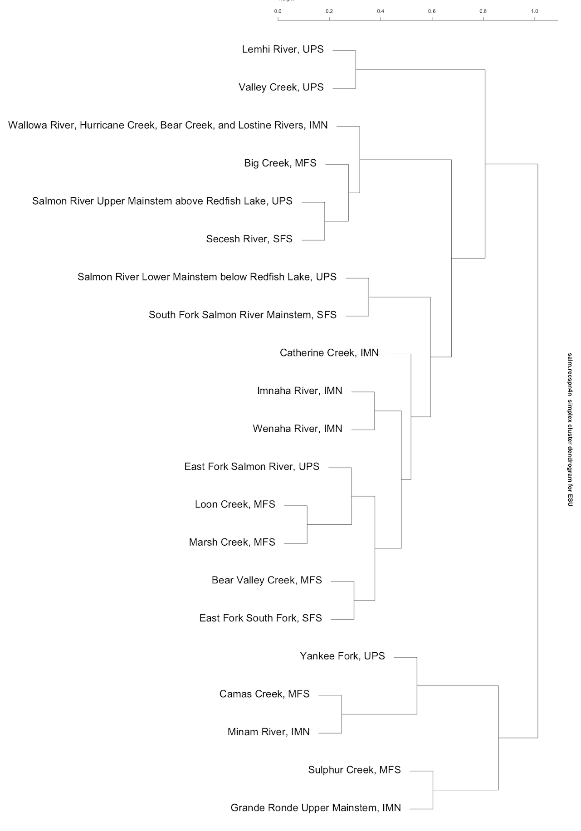
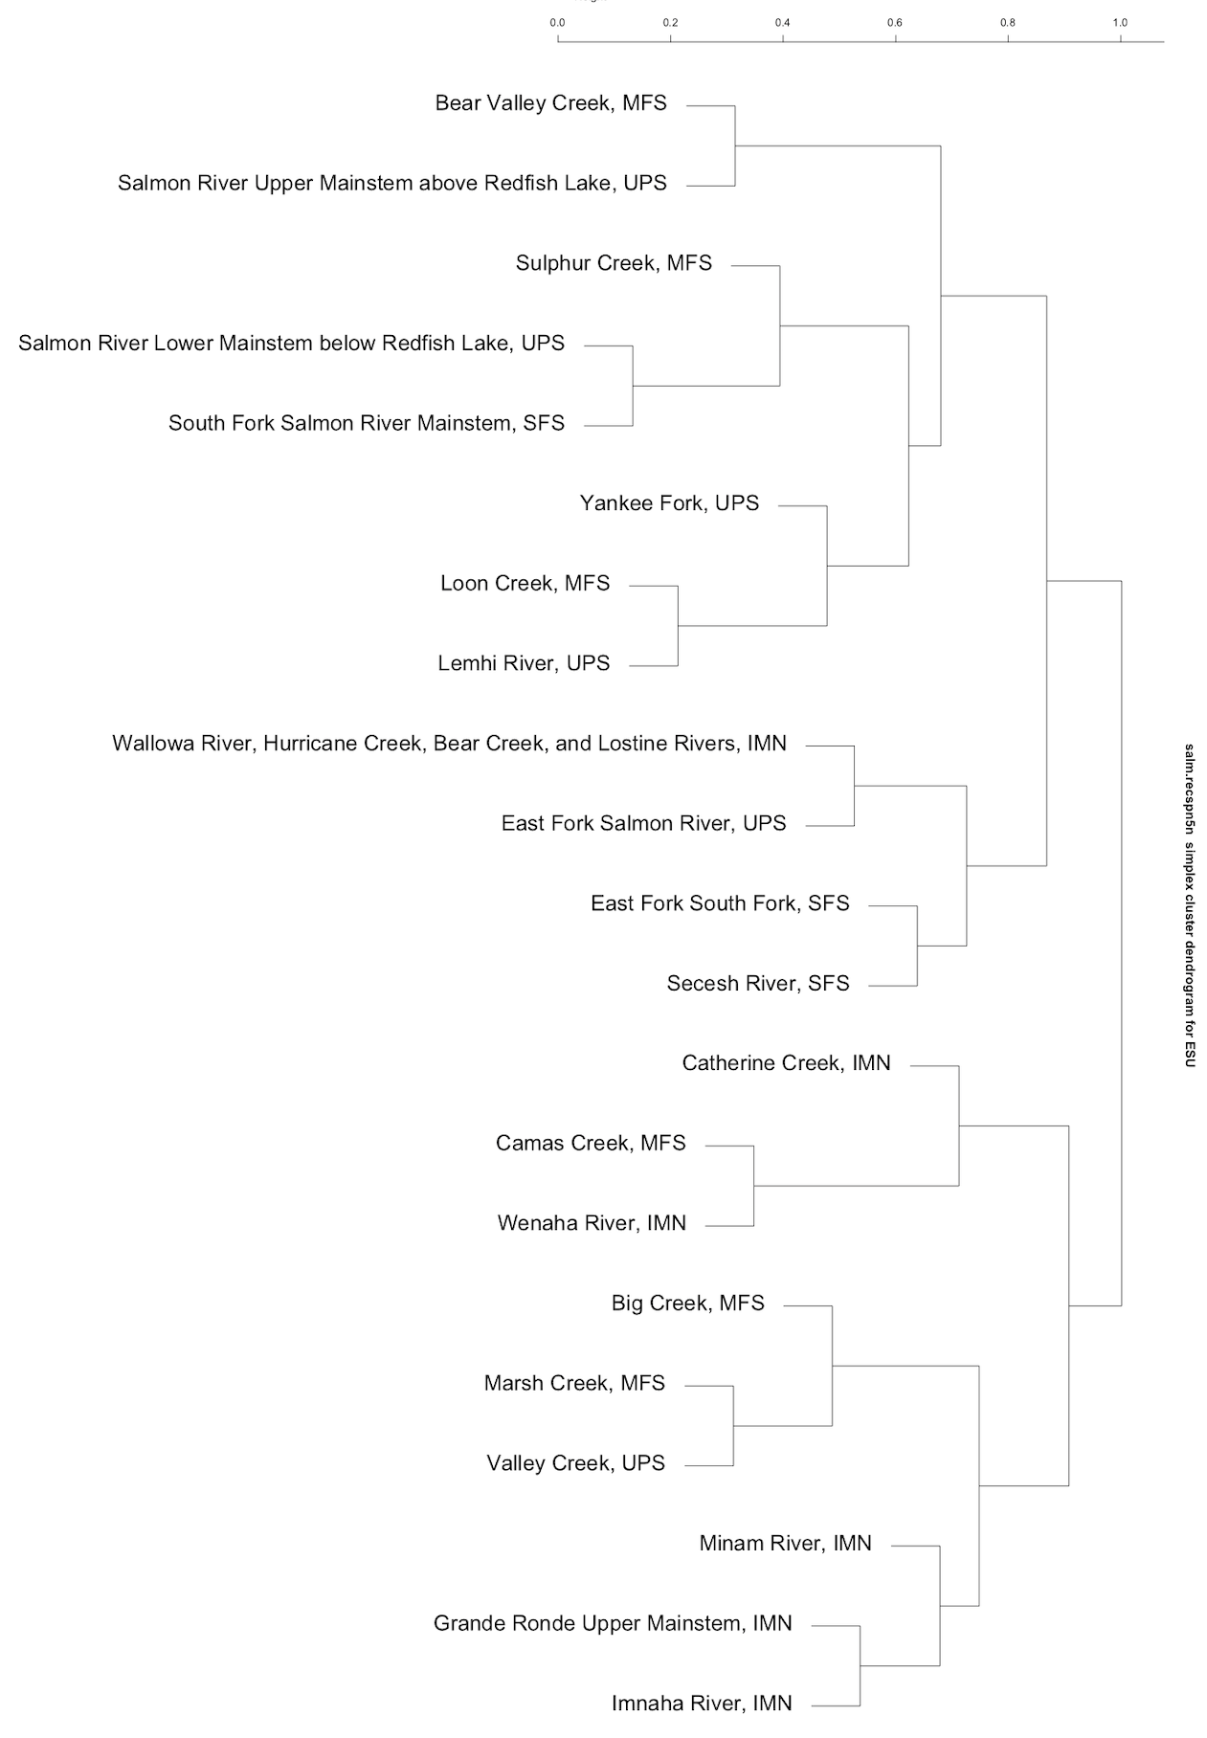
4-year old recruits per spawner
ESU
5-year old recruits per spawner
D_1
D_1
0000
D_2
D_3
D_2
D_3
D_4
D_4
D_5
D_5

Slide 3
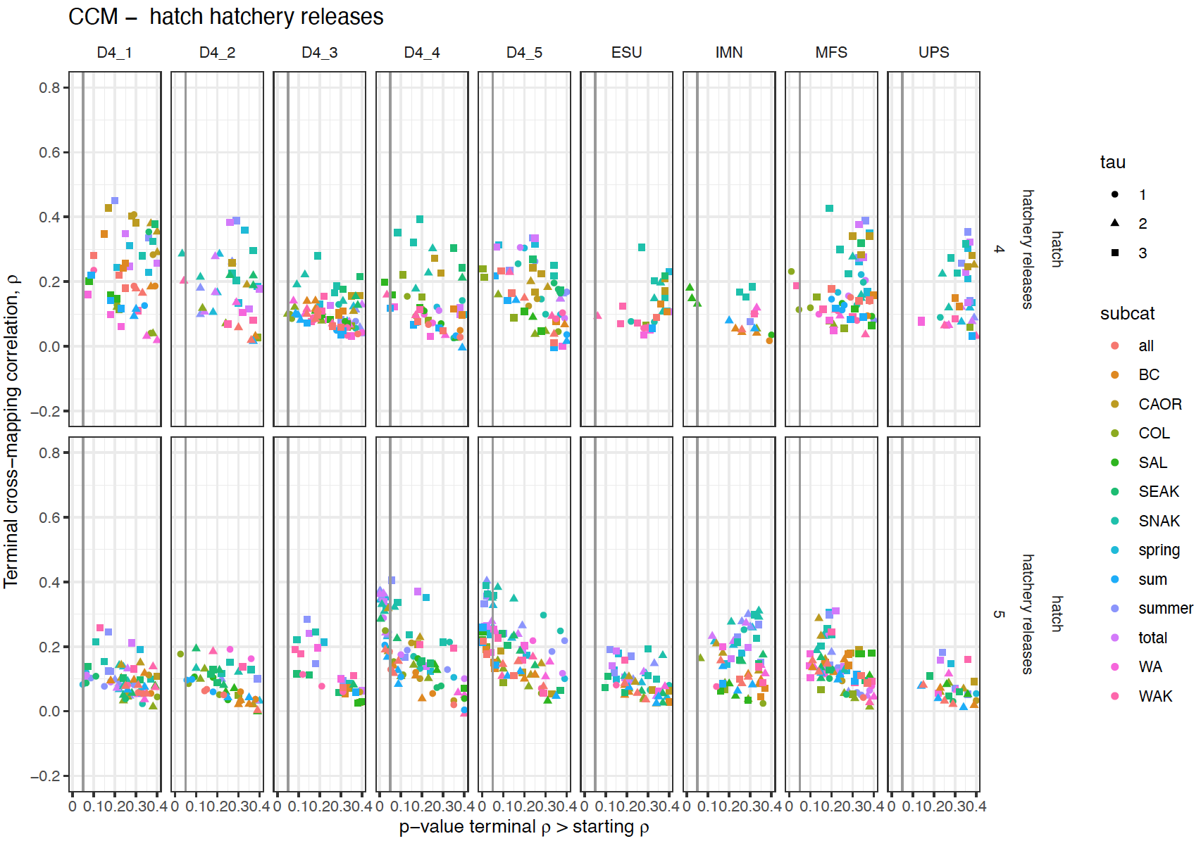
These are the CCM results (for hatchery releases) with 4yo recruits per spawner data on the top row and 5yo on the bottom. Each column is a different grouping of stocks. ESU include all stocks, IMN, MFS and UPS are the different MPGs. D4_1 through D4_5 are the groupings from the hierarchical analysis on slide 1. The terminal rho of the CCM is plotted against it’s p-value of the test that it is higher than the minimum library rho.
Note that many hatchery releases (particularly the SNAK) are only significantly causally related to the the hierarchical groupings and with a higher rho.

Slide 4
Middle Fork Salmon
4 year old recruits per spawner
MFS_1
MFS_1
Loon Creek and Marsh creek are very similar for rec4 but not for rec5.
5 year old recruits per spawner
MFS_2
MFS_2

Slide 5
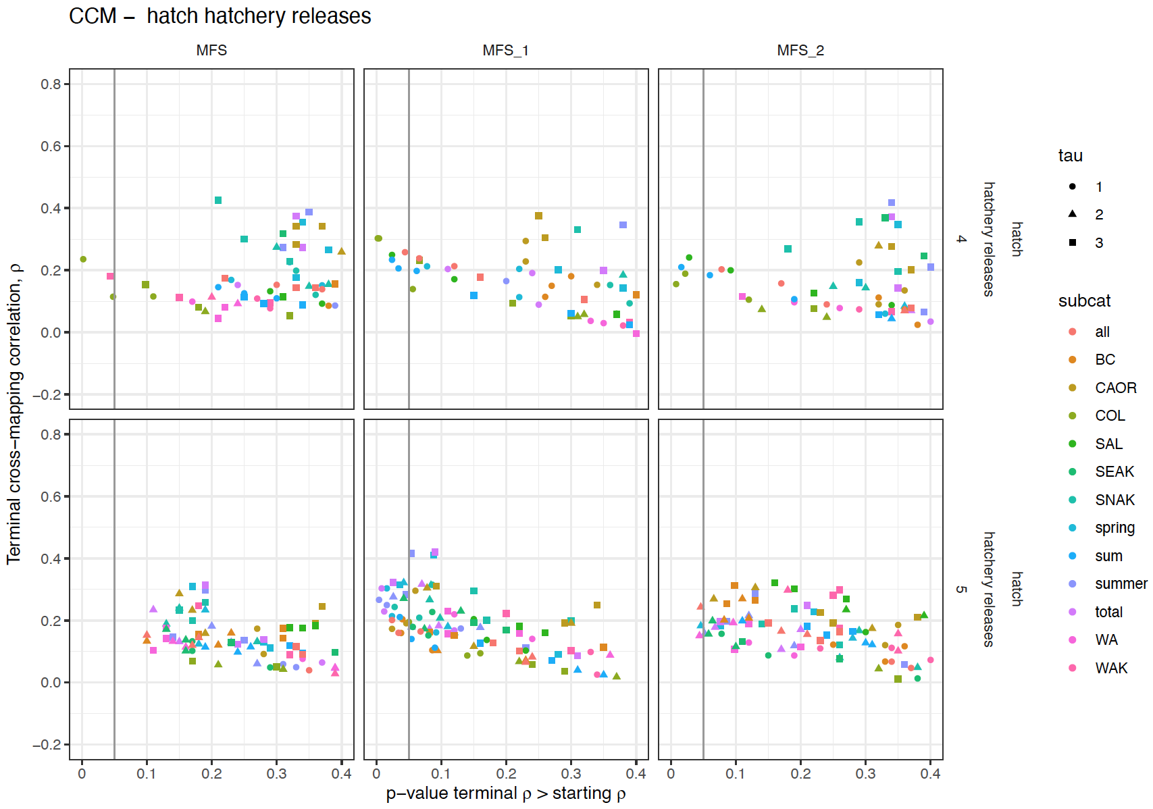
For Rec4, the smaller clusters show additional causal variables
For 5-year old recruits the effects are significant in the smaller clusters and with a higher rho.

Slide 6
Upper Salmon
UPS_1
UPS_1
4 year old recruits per spawner
The Salmon River above and below Redfish Lake are very similar for rec5 but not for rec4.
UPS_2
UPS_2
5 year old recruits per spawner
UPS_3

Slide 7
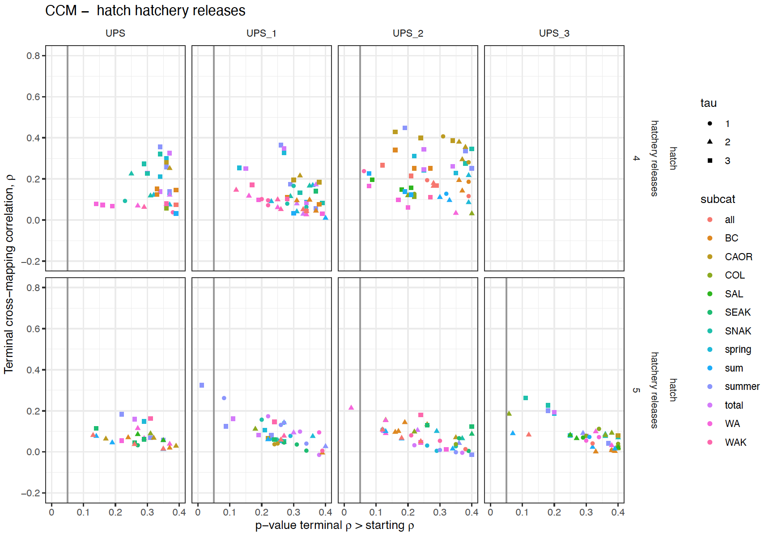
Different variables are causal for rec5 in the smaller USP clusters

Slide 8
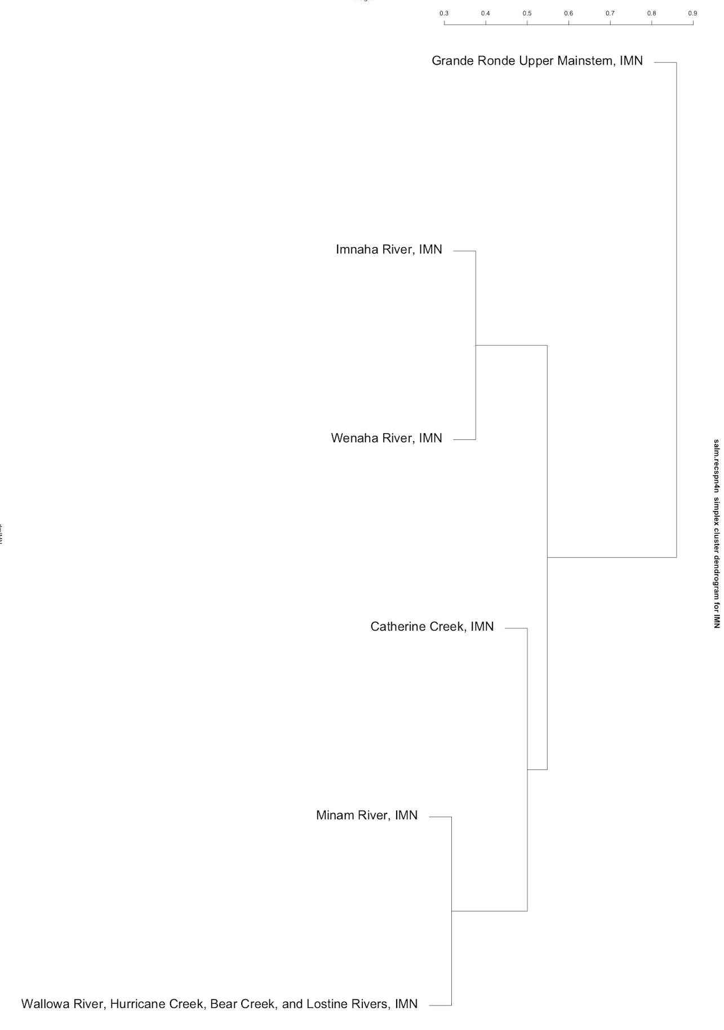
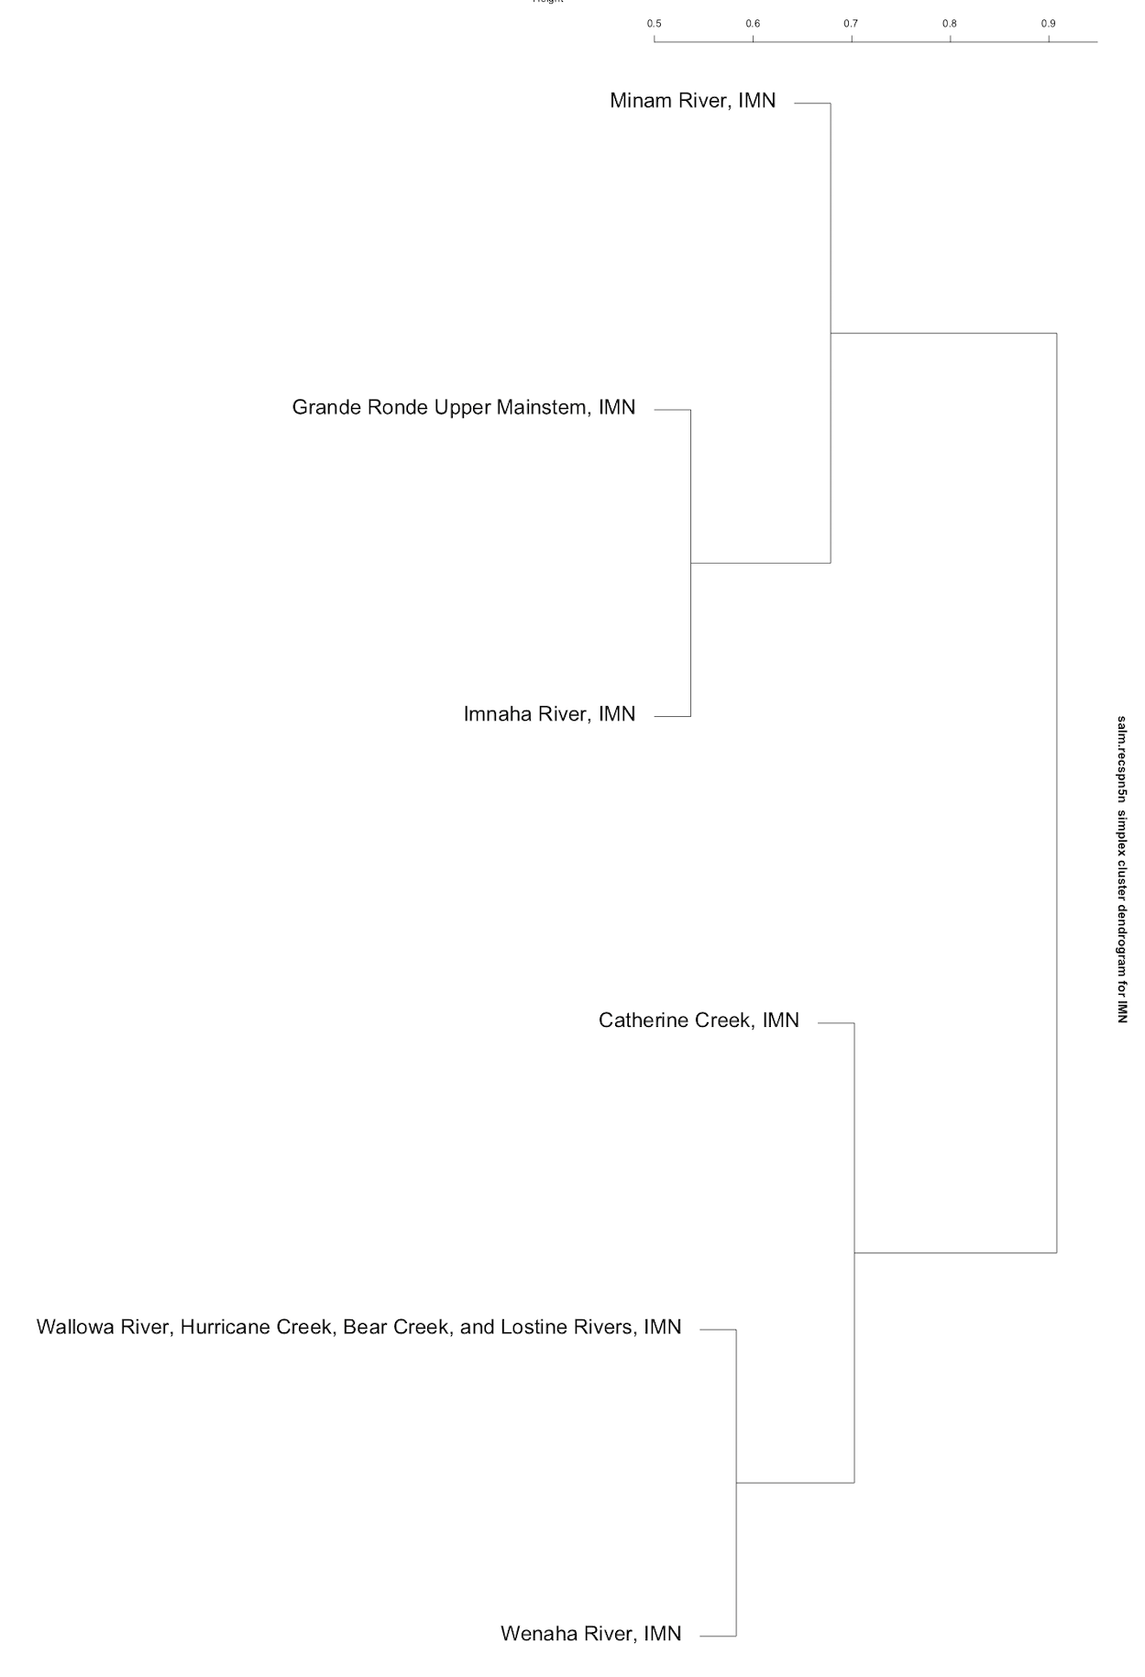
4 year old recruits per spawner
Imnaha
5 year old recruits per spawner
IMN_1
IMN_1
IMN_2
IMN_2
Lostine River and Wallowa contain the same data. Need to rerun this analysis without Lostine R. Explains why they predict each other so well for both rec4 and rec5.

Slide 9
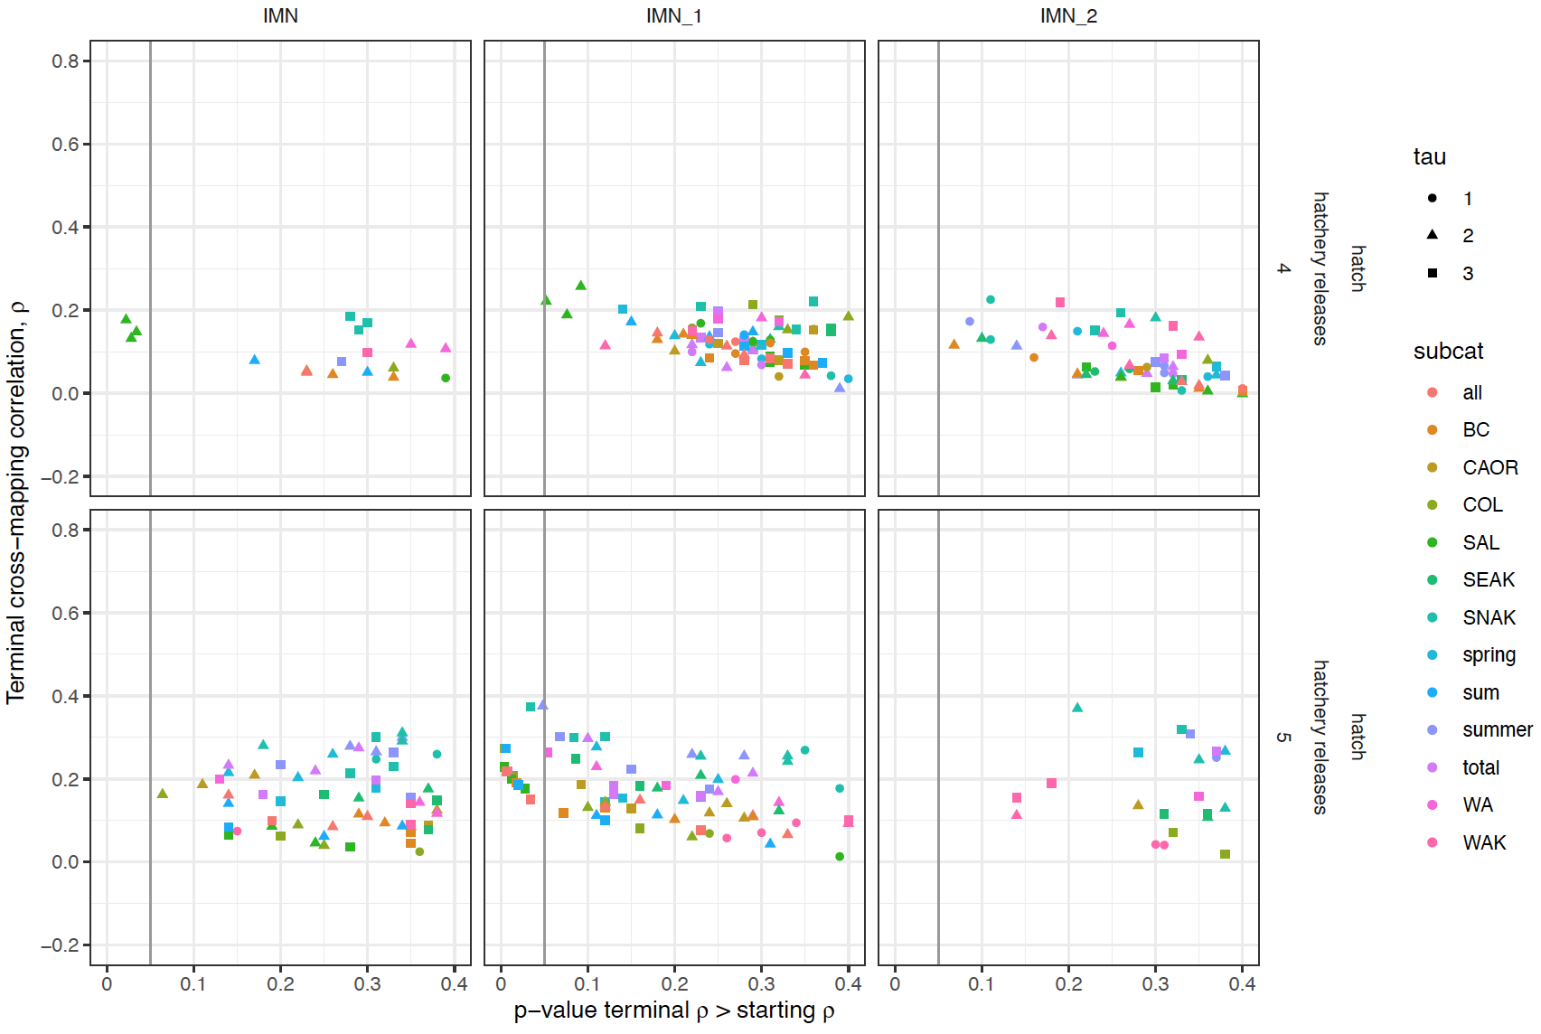

Slide 10
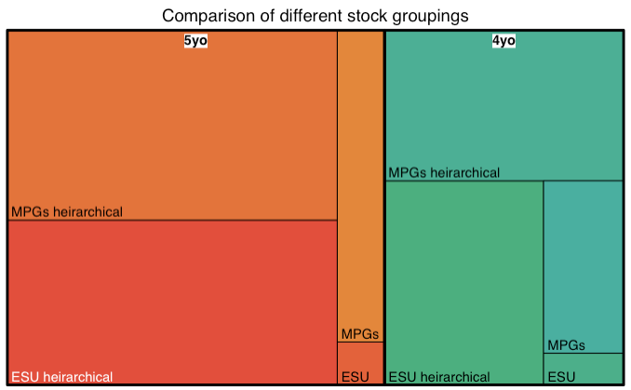
This treemap displays our hierarchical CCM results as a set of nested rectangles. Each group (and subgroup) is represented by a rectangle, in which the area is proportional to the terminal rho from the CCM of all the putative causal variables demonstrating significant convergence (the p-value of the test that the terminal rho is significantly higher than the minimum library rho was <= 0.1). If multiple tau for a causal variable had a p-value <= 0.1, only the tau with the highest rho was retained. If multiple offsets of a causal variable were significant, only the offset with the highest rho was retained.
The first grouping is for 5 year old (orange) vs 4 year old (green) recruits per spawner. The data for the 5 year old recruits had more significant causal variables.
Within each recruit age, we can compare the different ways the data are grouped.
‘ESU’ is for a CCM in which all the stocks are combined in the same attractor,
‘MPGs’ divides the stocks by the three main MPGs, Middle Fork Salmon, Imnaha, and Upper Salmon and excludes the South Fork Salmon and Lower Snake.
For both 4yo and 5yo recruits, the ESU level revealed the least causality, although it also has the smallest sample size whereas the MPGs have 3X as many CCM analyses, but even if you increase the size of the ESU box x3, more variables are causal at the MPG level.
This may be because there are different driving forces between the stocks and they don’t belong on the same attractor so there is little pattern in the attractor for all stocks combined. Alternatively, each stock may be on a different part of the same attractor but the sampling is insufficient or the stochasticity is so high that it can’t be resolved.
The stocks were also divided based on the simplex hierarchical analysis. The ‘ESU hierarchical’ arrangement is based on the hierarchical analysis of the whole ESU for 4yo and 5yo recruit per spawner data separately (slide 1). The ‘MPG hierarchical’ arrangement is based on the separate hierarchical analyses of each MPG (slides 3, 5, 7).
Although these are the biggest boxes, they also have more analyses. ‘MPG hierarchical’ has 6-7x as many analyses and ‘ESU hierarchical’ has 5x as many analyses than the whole ESU level. MPG hierarchical has 6-7x as many analyses

Slide 11
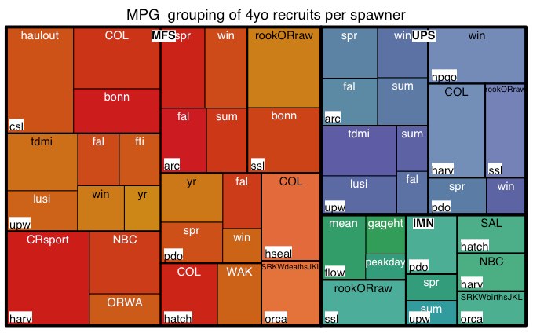
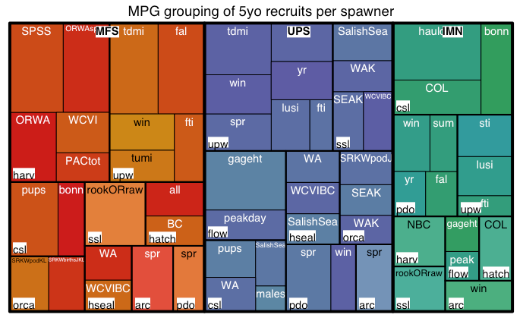
MPGs with the most significant causal relationships within the ESU

Slide 12
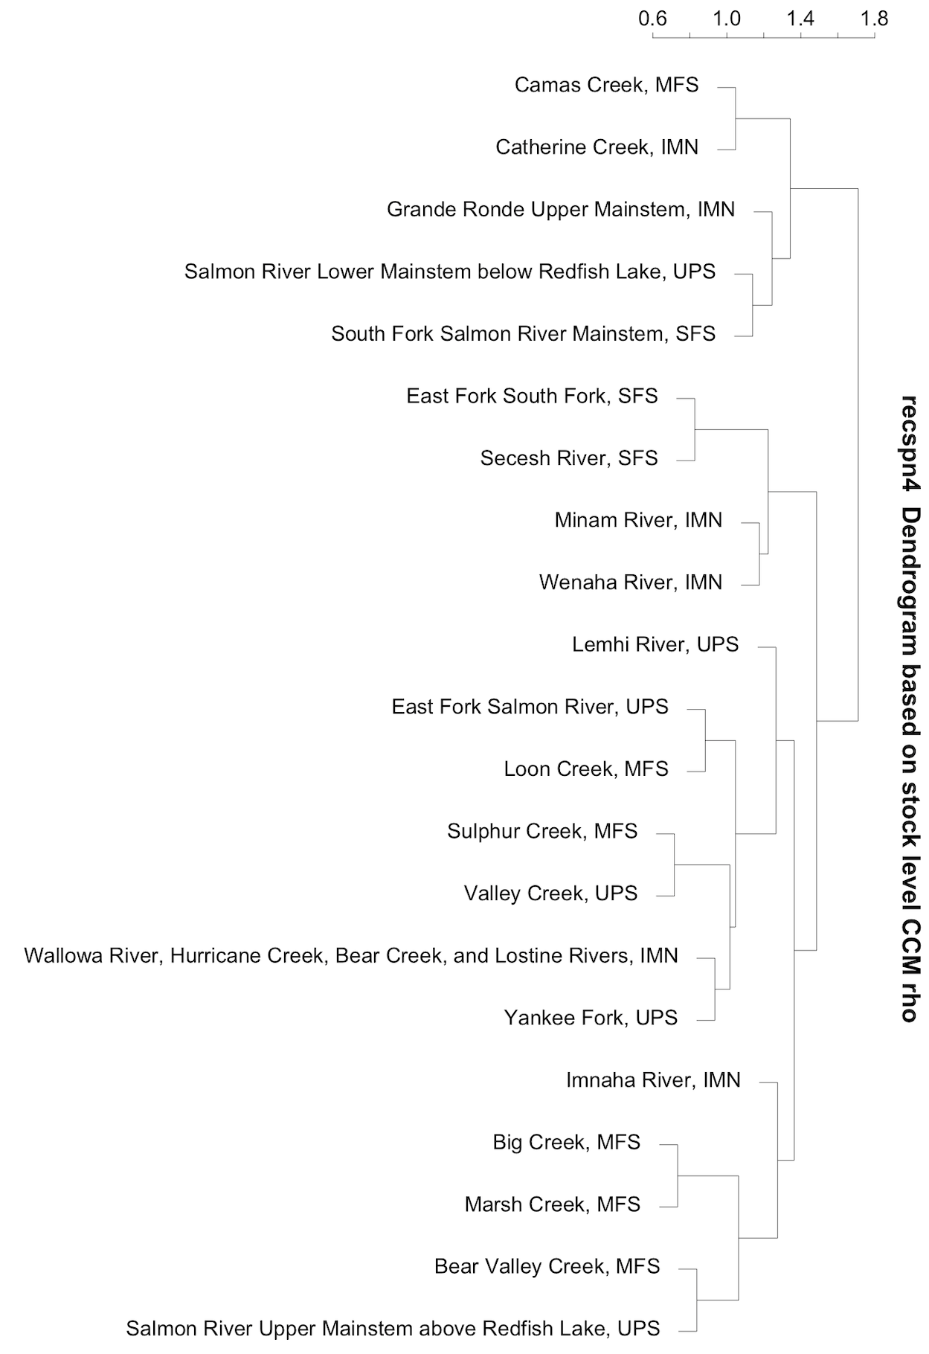
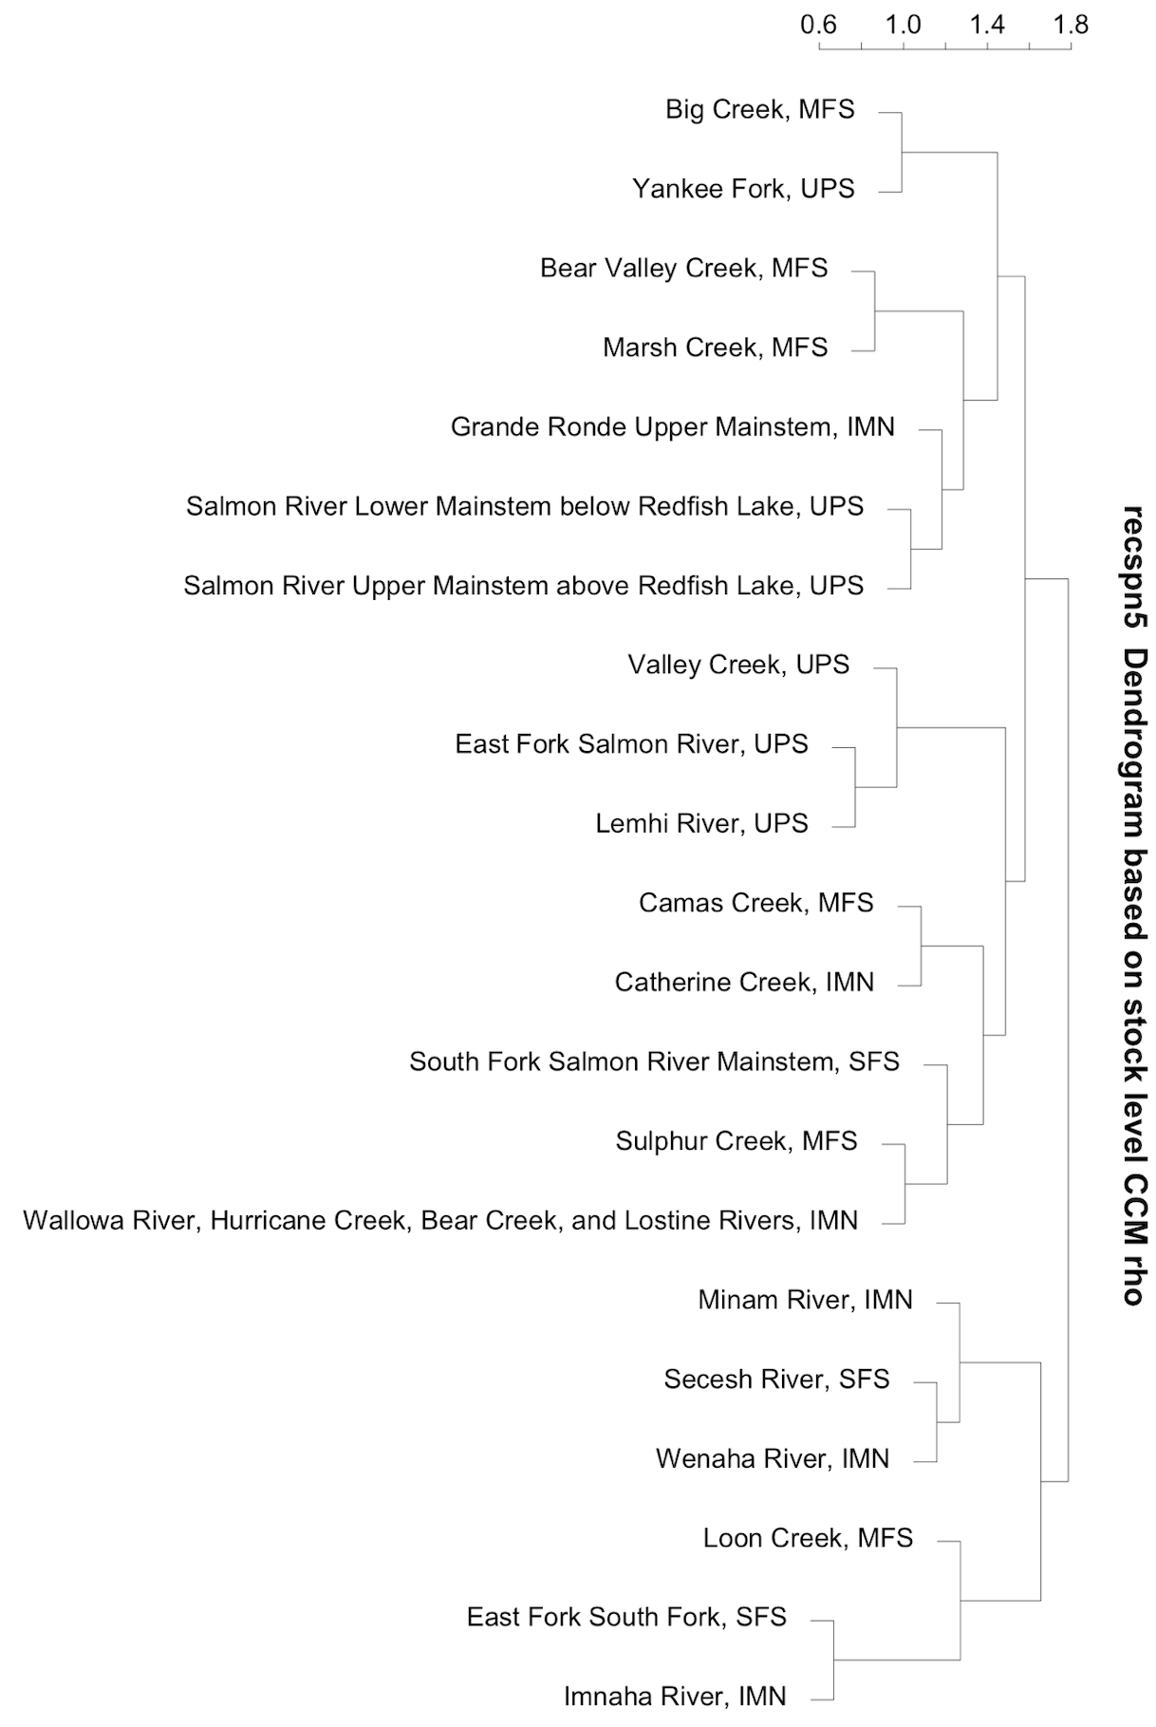
Cluster stocks based on stock level CCM rho
D_1
D_1
D_2
D_2
D_3
D_3
D_4
D_4

Slide 13
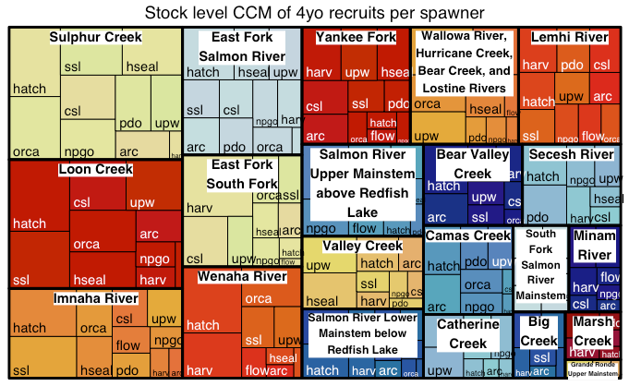
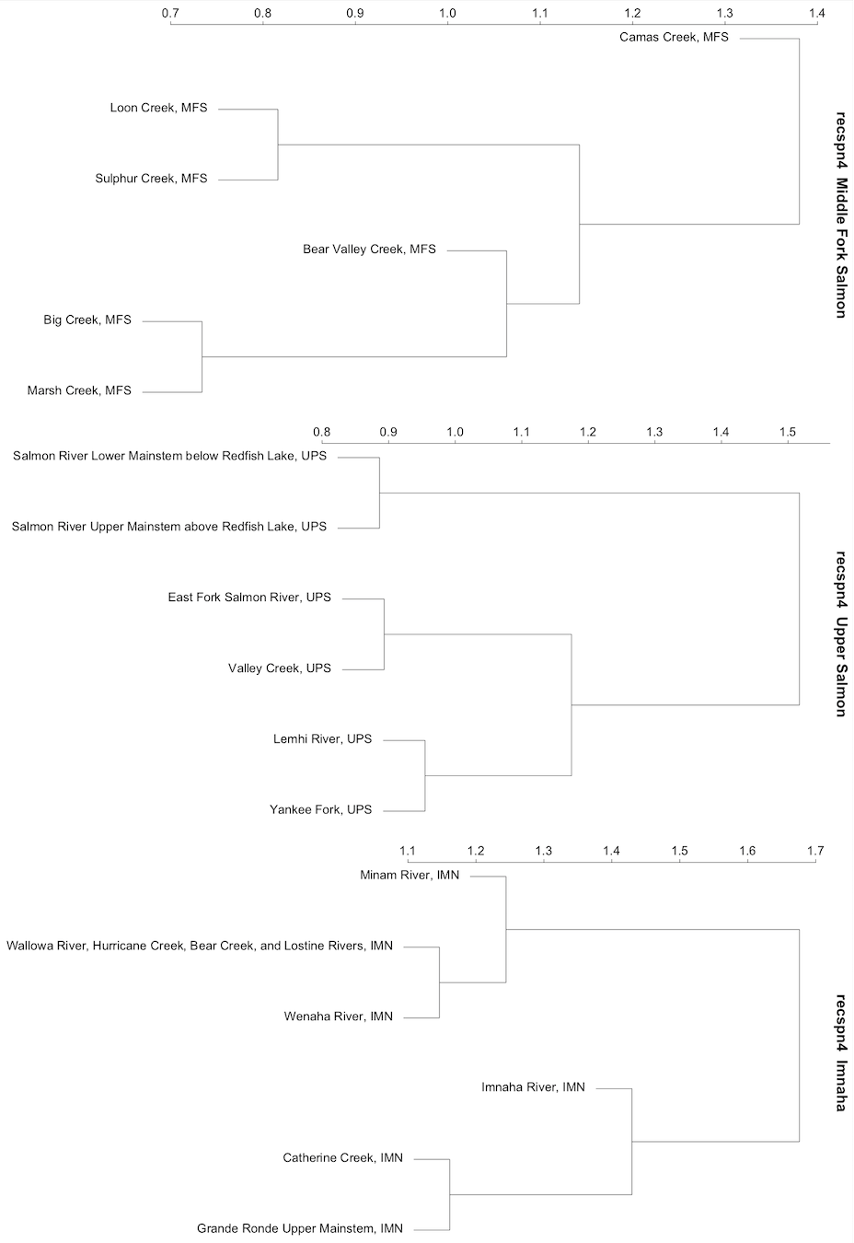
CCM at the stock level – recspn4

Slide 14
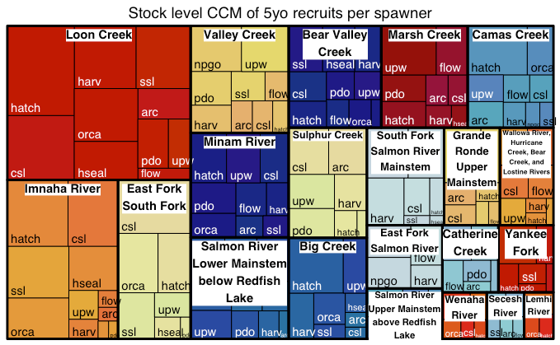
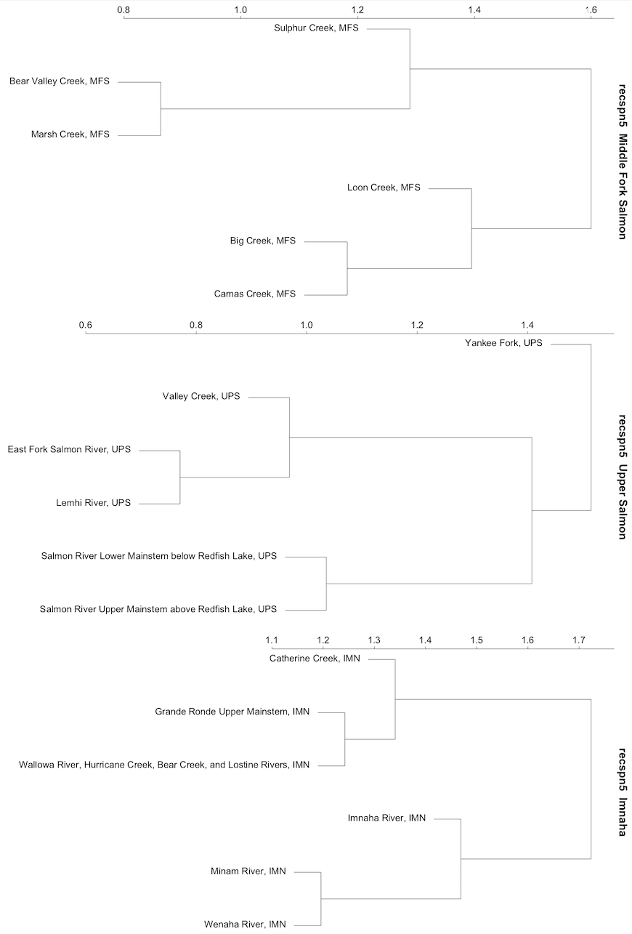
CCM at the stock level – recspn5

